Slide 1
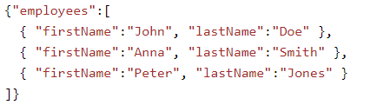
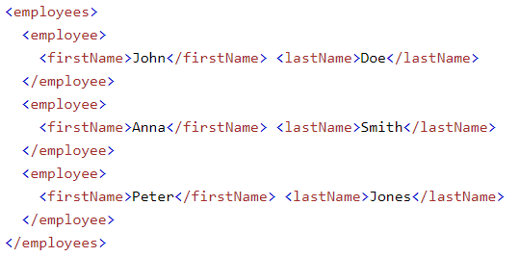
JSON Vs. XML
The following JSON and XML examples both define an employees object, with an array of 3 employees
JSON Example
XML Example

Slide 2
JSON Vs. XML
JSON is Like XML Because
Both JSON and XML are "self describing" (human readable)
Both JSON and XML are hierarchical (values within values)
Both JSON and XML can be parsed and used by lots of programming languages
Both JSON and XML can be fetched with an XMLHttpRequest
JSON is Unlike XML Because
JSON doesn't use end tag
JSON is shorter
JSON is quicker to read and write
JSON can use arrays
XML has to be parsed with an XML parser. JSON can be parsed by a standard JavaScript function
Why JSON is Better Than XML?
XML is much more difficult to parse than JSON.
JSON is parsed into a ready-to-use JavaScript object.

Slide 3
JSON Vs. XML
For AJAX applications, JSON is faster and easier than XML:
Using XML
Fetch an XML document
Use the XML DOM to loop through the document
Extract values and store in variables
Using JSON
Fetch a JSON string
JSON.Parse the JSON string

